Slide 1
12 Christmas Eve dishes

Slide 2
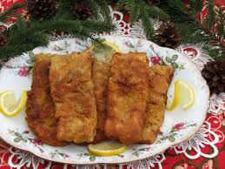
CARP

Slide 3
RECIPE
Pull the bones out of the carp, cut into smaller pieces. Sprinkle with salt and pepper. Peel and cut vegetables into thin slices.
In a bowl, cover the carp with vegetables put the carp into the fridge overnight. Remove from the fridge. Cover the carp in flour, beaten egg and breadcrumbs. Fry in oil until golden brown on both sides.
Fry it slowly. Put the fried carp into an ovenproof dish and put in the preheated oven for 30 minutes.
Components:
1 carp
Oil
Salt, pepper
Half pack of vegetables
Flour
Bread crumbs
2-3 eggs

Slide 4
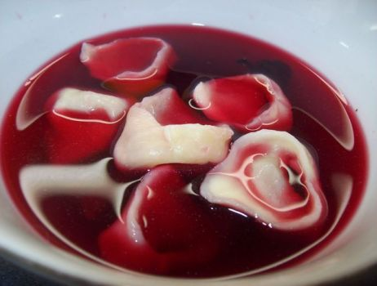
RED BORSCHT WITH DUMPLINGS

Slide 5
RECIPE
Components
25 dag of beetroot
half a bunch of vegetables
1 and 1/2 onions
1 clove of garlic
1 bay leaf
5 grains of black pepper
salt
1 tbsp of beetroot concentrate
1/2 cup flour
2 dag of cooked dried mushrooms
1/4 bunch of chopped parsley
1 egg
1 tbsp of oil
dried marjoram
1 Peel the vegetables, cut into pieces. Transfer to a saucepan, pour 3/4 litres of water. Add bay leaf, pepper, peeled onion. Boil the decoction, add peeled and grated beets and garlic with salt. Boil 30 minutes.
2. Strain, season with salt, pepper and concentrate. Knead the dough from flour, salt and lukewarm water. Chop half an onion, and fry it in oil. Mix with chopped mushrooms, parsley and egg, season it.
3. Roll out the dough, cut out circles, place a portion of stuffing on each. Shape the dumplings and cook them in salted water. Ready portions put on plates pour borscht sprinkle with marjoram. Beetroot borscht is ready.

Slide 6
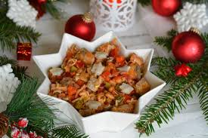
HERRINGS

Slide 7
RECIPE
Components
750g herring flaps
4 pickled cucumbers
1 red pepper
1 small chilli pepper
1 red onion
100g leek
1 tbsp vinegar
salt
pepper
Sauce:
3 garlic cloves
2 tbsp mustard
6 tbsp of oil
1/2 tsp brown sugar
6 tbsp of spicy ketchup
1/2 tsp ground hot pepper
pepper
Soak the herring fillets in clean water with vinegar for about 3-4 hours. After this time, cut into larger cubes. Chop canned cucumbers, onions and peppers. Cut leek into slices and then in half. Grate the garlic finely. Mix the sauce ingredients together and then season with pepper. Transfer all salad ingredients to a large bowl, add the sauce and mix thoroughly. You can season with salt, pepper and put in the fridge so that the flavors combine.

Slide 8
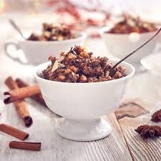
KUTIA

Slide 9
RECIPE
Components
200 g wheat
200 g of dry poppy
4 tbsp of liquid honey
1 tsp of lemon juice
100 g of raisins, soaked in hot water
50 g chopped walnuts,
50 g flaked almonds, chopped
1 tsp almond extract
Pour the wheat with cold water and leave it to soak overnight, then strain, pour fresh water and cook until soft (2 - 3 hours), strain and pour cold water.
Transfer poppy seeds to a medium pot, pour boiling water, cover and leave for 30 minutes, then strain and grind.
mix poppy seeds, wheat, nuts, honey, almonds, raisins and lemon juice in in a large bowl.
Put it in the fridge for a few hours to cool.
Put into small bowls, decorate with a spoon of sweet cream and a few flakes of almonds.

Slide 10
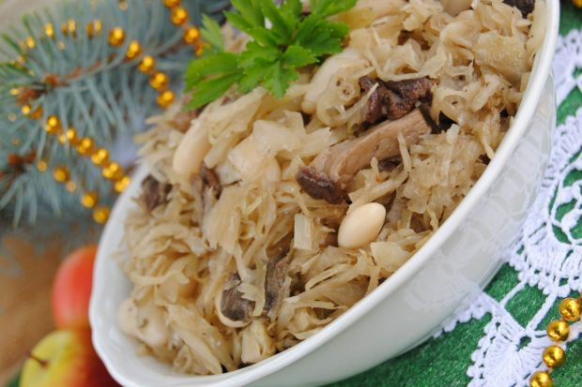
CABBAGE WITH PEAS

Slide 11
RECIPE
Components
1 kg of sauerkraut,
Half a cup of shelled peas,
1 onion,
Oil for frying,
2 bay leaves,
Salt, freshly ground pepper,
Marjoram,
8-10 dag of dried mushrooms
Soak the mushrooms in water. Leave it for the night. Soak the peas and leave them overnight. Pour water into a pot and cook the cabbage until tender with the addition of bay leaves. Drain the ready cabbage and chop it gently. Dice the onion and fry it in oil until golden brown. Add shredded cabbage to it and fry together. In the meantime, cook peas and mushrooms in water in which they soaked. Drain cooked peas. When the mushrooms are ready, along with the decoction, water the cabbage with them and stew together to evaporate the water. Season to taste. Add peas and mix.

Slide 12
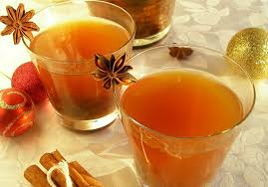
DRIED FRUIT COMPOTE

Slide 13
RECIPE
Components
2 litres of water
100 grams of dried apples
100 grams of dried apricots
50 grams of dried plums
50 grams of dried figs
2 tbsp of sugar
4 tbsp of orange juice
1 cinnamon stick
1 piece of anise
8 pieces of carnations
Pour water over fruit and let stand for 2-3 hours. Boil it. Add sugar, anise, cinnamon, cloves, sugar, lemon and orange juice. Cook the fruit to simmer. Prepared compote aside to cool, then pour it into a jug.

Slide 14
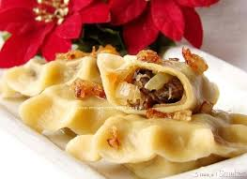
DUMPLINGS WITH CABBAGE AND MUSHROOMS

Slide 15
RECIPE
Components
DOUGH: 350g wheat flour (about 2 cups)
200 ml warm water
1 egg
1 tbsp of butter
pinch of salt
FILLING: half a kilo of sauerkraut
10 dag of dried mushrooms
1 large onion
Oil
salt pepper
Soak the mushrooms in cold water for at least 2 hours, cook until soft. Sauerkraut, if it is too sour, lightly squeeze, throw into a saucepan, add water and cook. Squeeze the sauerkraut to get rid of water and chop it finely, similarly prepare mushrooms. Chop the onion finely and fry in oil. Stew mushrooms and sauerkraut together. Transfer everything to a deep bowl, season with salt and pepper. Sift flour, make a hole, stick an egg into it and pour a tablespoon of melted butter. Add salt. Slowly pour in an incomplete glass of warm water, actually as much as "the flour takes". Knead the dough until it is flexible and smooth. Leave it for half an hour, then divide into about 4 portions and roll out to a thickness of about 2mm. Cut out circles with a special mold or glass (I cut out with a glass). Apply the stuffing to the center of the rings, fold them in half and stick the edges into dumplings. You can decorate knead dumplings with a fork. In a large pot, boil water with salt and a tablespoon of oil. Put a dozen of dumplings on boiling water, stirring from time to time with a wooden spoon so that they do not stick to the bottom. Boil until soft, for about 3-5 minutes. Serve with chopped onion in butter.

Slide 16
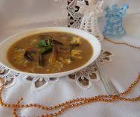
MUSHROOM SOUP

Slide 17
RECIPE
Components
100 g dried mushrooms
130 g peeled carrot
65 g peeled parsley - root
60 g of peeled celery root
60 g peeled onion
3 medium garlic cloves
4 allspice
2 bay leaves
salt, black pepper
parsley
2 tbsp of clarified butter
2 heaped tbsp of wheat flour
2 tbsp of 18% sour cream
pasta
Put dried mushrooms into a pot with cold water, leave for a few hours. Then, in the same water, cook the mushrooms until tender.
Strain them. Leave about 2 tbsp of mushrooms. Peel all the vegetables. Cut the vegetables into larger columns. Throw them in a decoction of mushrooms. Pour water. Mix the cream and flour thoroughly. Cook the soup, add spices - to taste. Cut finely 2 tablespoons of mushrooms, fry in butter, together with chopped onion. Squeeze garlic. Pour sour cream mixed with flour. Add fried mushrooms. Boil slightly. Add chopped parsley before serving.

Slide 18
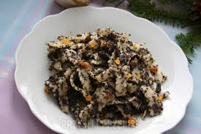
NOODLES WITH POPPY SEEDS

Slide 19
RECIPE
Components
Noodles:
3 glasses of flour
3 eggs
about 1/4 cup of water
pinch of salt
Poppy seed mass:
100 g poppy seeds
1 tbsp of honey
2 tsp of butter
a few drops of almond aroma
1 tbsp of candied orange peel
1 tbsp of chopped nuts
1 tbsp of raisins
Knead a hard dough. Roll out thinly, cut into strips and cut thick noodles. Boil in salted water. Pour cleaned poppy seeds with boiling water and cook for 10 minutes. Strain and grate after cooling. Heat butter in a pan, add poppy seeds, dried fruit, aroma, honey and fry for a while. Insert cooked pasta and mix.

Slide 20
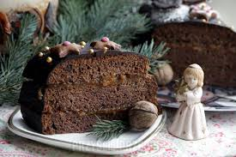
GINGERBREAD

Slide 21
RECIPE
Components
CAKE
2 eggs
0.5 glasses of icing
2 glasses of cake flour
150g of liquid honey
125 ml of 18% sour cream
100g of butter
4 tbsp of oil
4 tbsp of milk
1 flat tsp of baking soda
1 tbsp of gingerbread spice
2 tsp kakako
ICING
50g milk chocolate
4 tbsp of milk
40g butter
ADDITIONALLY
jam, e.g. plum
Add all the ingredients for the dough to the bowl - everything is mixed to a homogeneous mass. Pour the dough into the mold. Then cut into 3 parts and spread plum jam on them. The ingredients for the glaze are put into a bowl and dissolved over a water bath - mix until a homogeneous mixture. Glaze over the entire gingerbread and decorate it with sugar additives.
Keep it in the fridge or cake container.

Slide 22
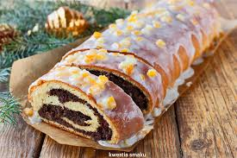
POPPY SEED CAKE

Slide 23
RECIPE
Components
YEAST CAKE
500 g of wheat flour
50 g of fresh yeast
50 g of sugar
200 ml of milk
4 yolks
50 g of butter
POPPY SEED MASS
850 g of ready poppy seed mass
4 yolks
50 g of nuts and dried cranberry
2 tbsp of breadcrumbs
Pour flour into a bowl, make a hole, add yeast and sprinkle with sugar. Gradually pour warm milk into the hole, mixing it with the yeast and scooping a few tablespoons of flour inside. Cover with a cloth and let stand for 10 minutes to rise. Add eggs and start gently mixing all ingredients with a spoon. When they coarsely combine, add melted, warm butter and start kneading the ingredients. Knead the dough for approx. 10 - 15 minutes until it is smooth and elastic. Form a ball, place it in a bowl and set aside in a warm place for about 1 hour to rise. Mix the poppy seed mixture with chopped nuts, chopped cranberry and breadcrumbs. Beat yolks to a stiff foam with a pinch of salt, gently mix with the mass of poppy seeds. Put the dough on the pastry board and knead for a while, divide it into 2 parts. Roll out one part of the dough into a rectangle measuring approx. 30 x 35 cm, put half the poppy seed mass, keeping approx. 1.5 cm free edge. Roll the roulade along the long side and stick the edges together, put on greased baking paper. Wrap the strudel in paper, leaving about 2 cm of free space inside for the dough to rise. Repeat with a second piece of cake. Place the two poppyseed cakes (together with the paper) downwards on a large baking tray and set aside for about 20 minutes to rise. Bake for 35 minutes in an oven preheated to 180 degrees C. After cooling, pour icing: mix hot lemon juice with orange peel gradually adding powdered sugar.

Slide 24
BREAD

