Slide 1


Christmas traditions
in
Poland

Slide 2
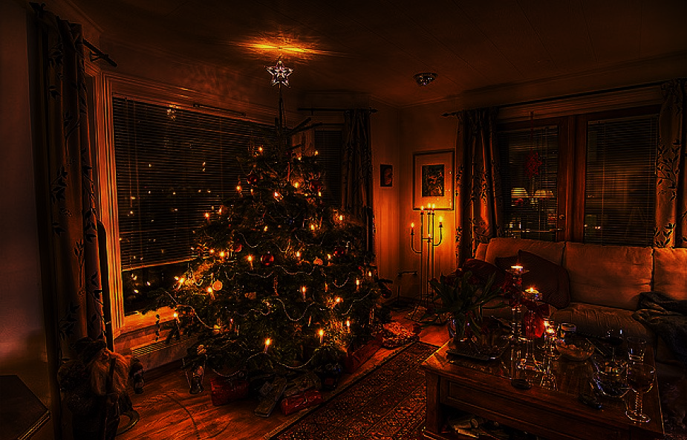
Christmas
tree

Slide 3
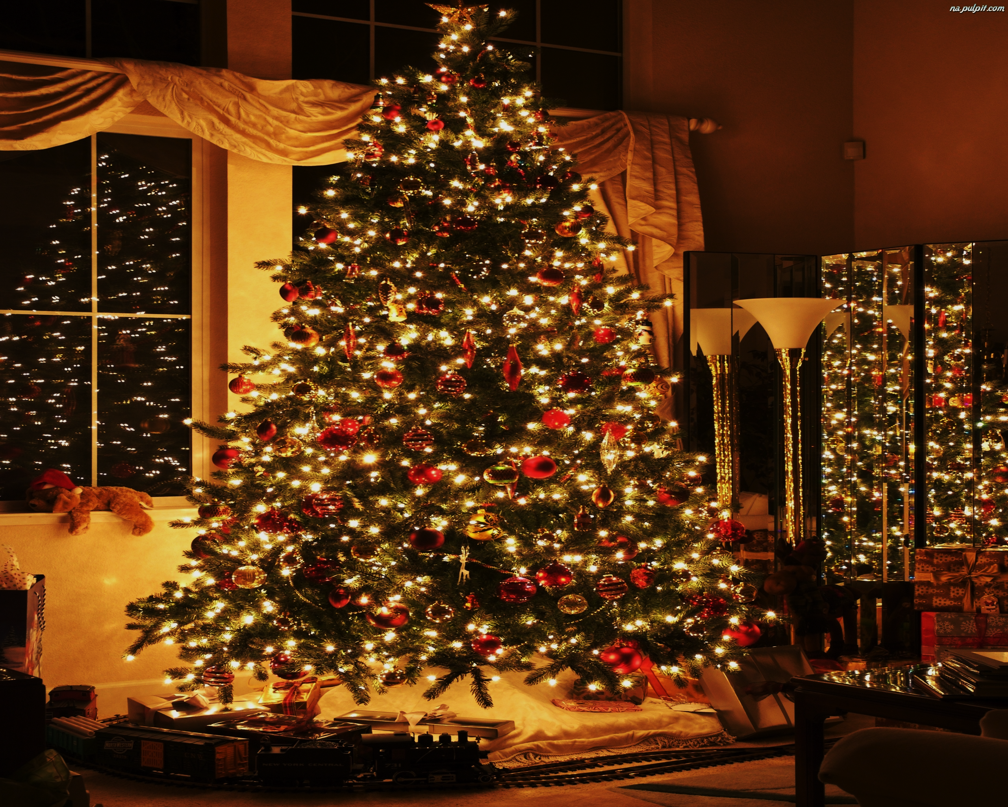
Christmas trees are one of the customs most associated with holidays. We put them at home and decorate them.

Slide 4
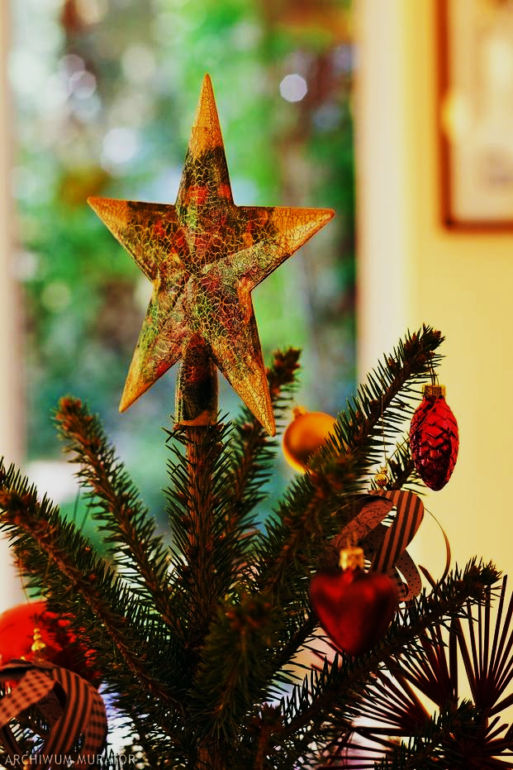
In the 19th century, a star began to be placed on the top of the fire that reminds us of the Bethlehem star.

Slide 5
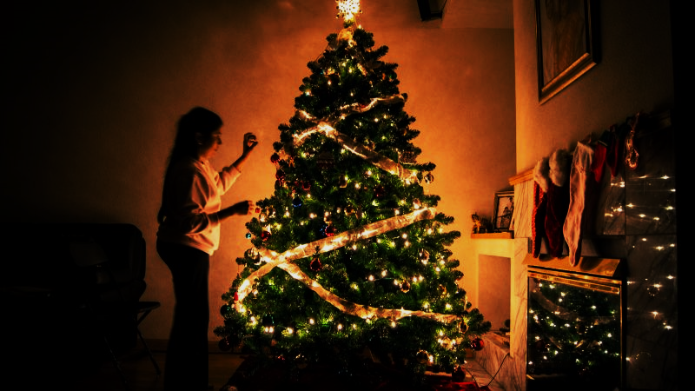
We do not dress
Christmas trees
until Christmas Eve.
However, to light the lamps,
you have to wait for
the first star to appear in the sky.

Slide 6
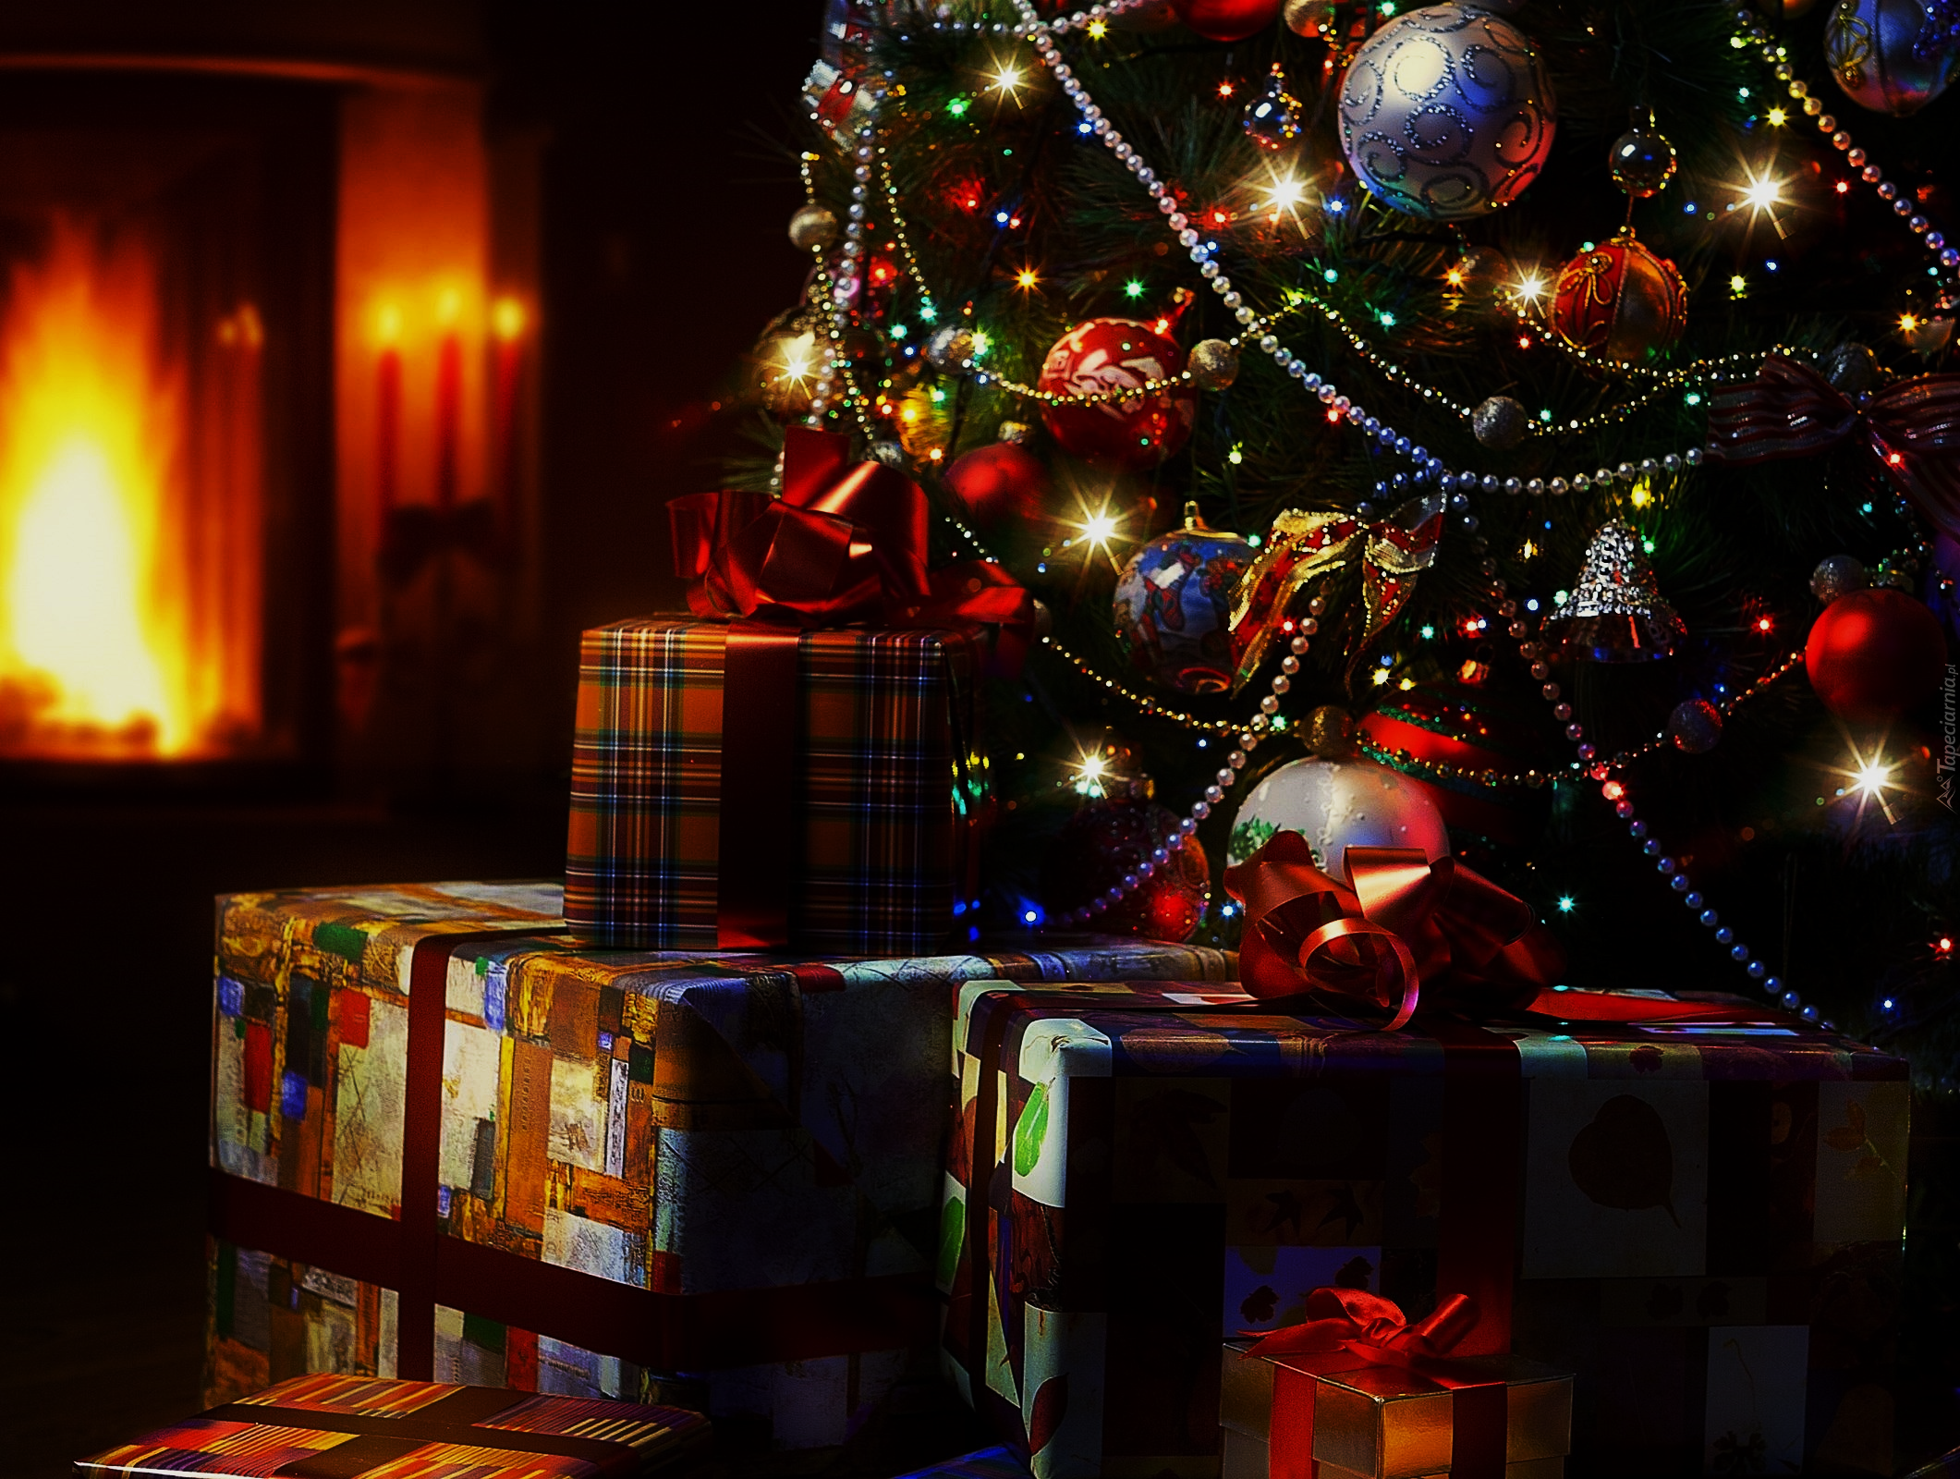
Presents

Slide 7
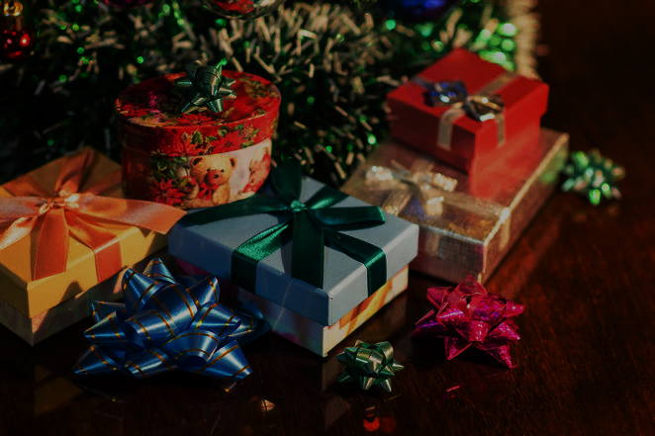
The custom of exchanging presents (especially to children) is associated with the life of Saint Nicholas.
His extraordinary generosity, care for the poor, have become a symbol of love for each neighbor.

Slide 8
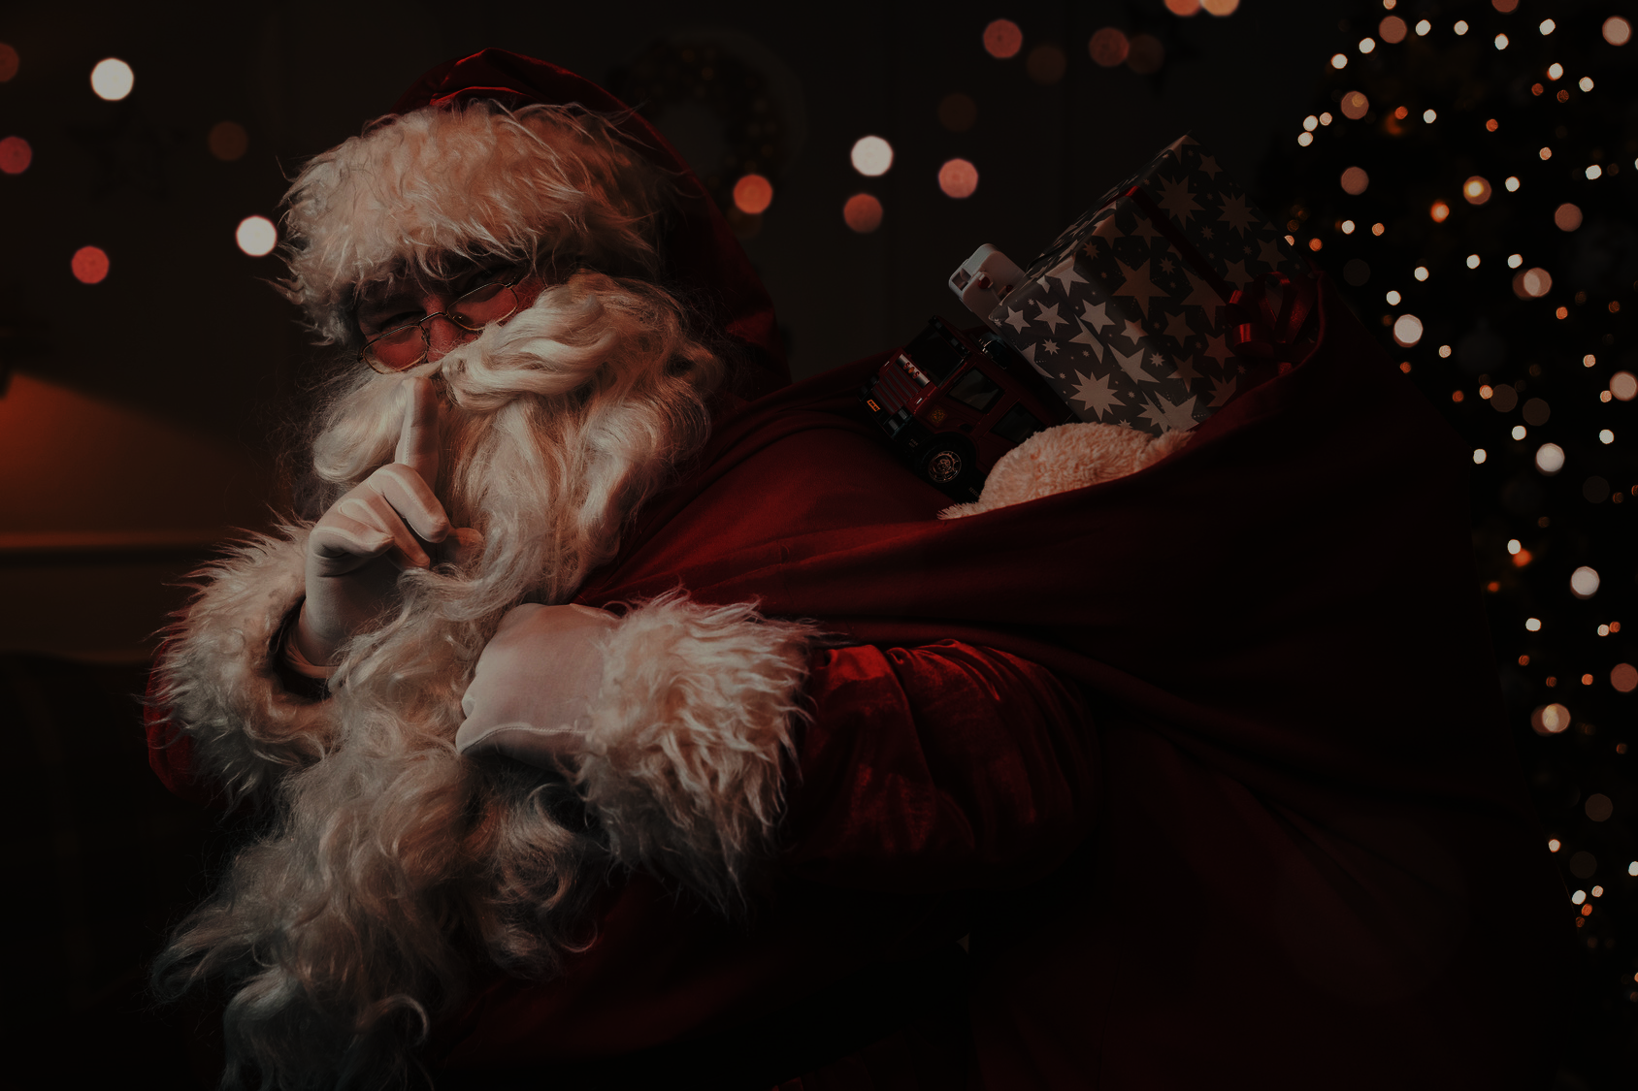
Saint Nicholas, according to Polish folk beliefs
also gave presents to animals.

Slide 9
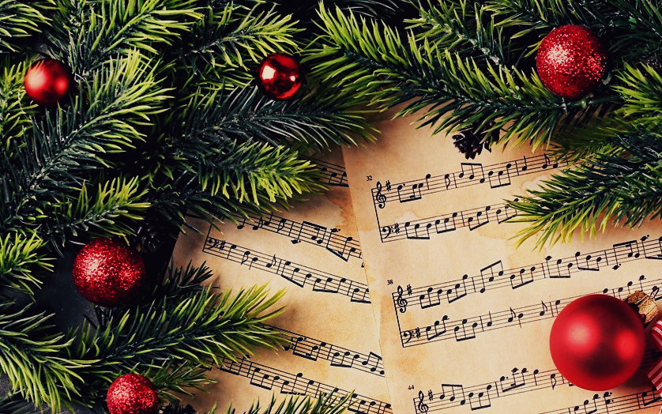
Christmas carols

Slide 10
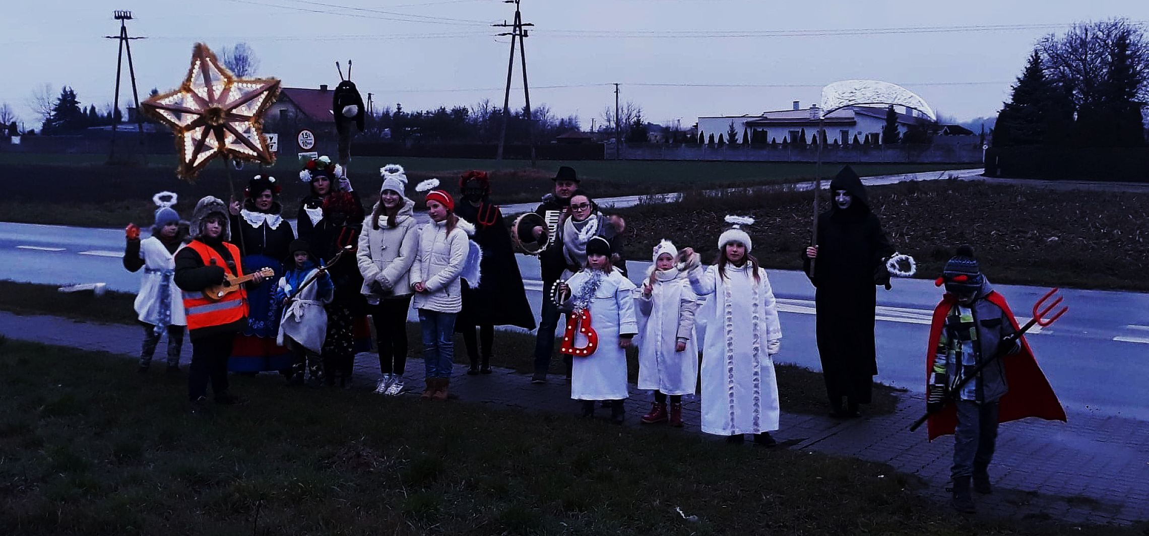
Carol in Poland means above all a religious song, thematically related to the birth of Christ.

Slide 11
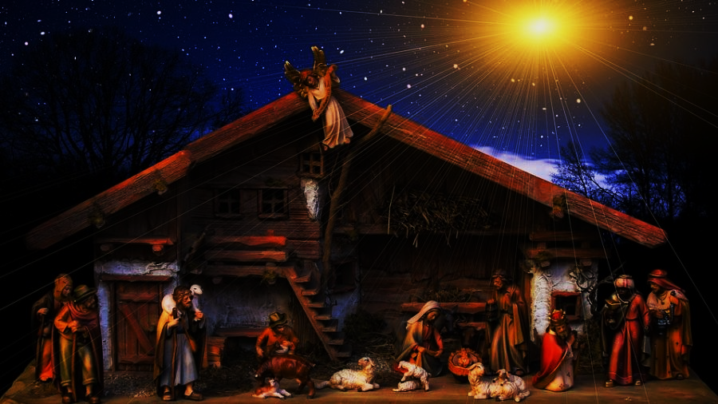
The oldest Polish Christmas carol "Zdrów be king angel".
The most traditional Polish carol is "God is born".
However, the most famous in the world is "Silent Night"

Slide 12
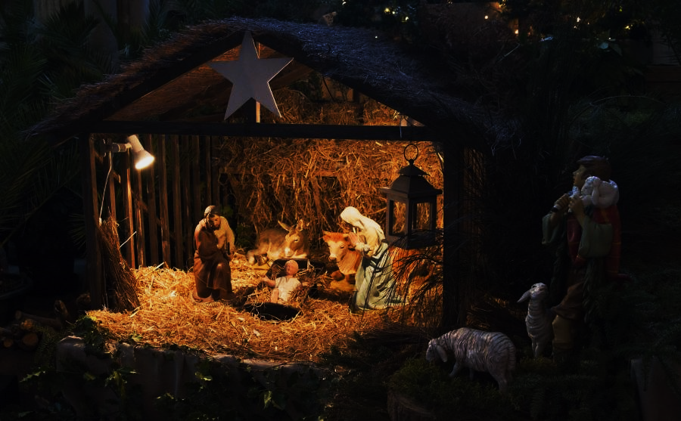
Cribs

Slide 13
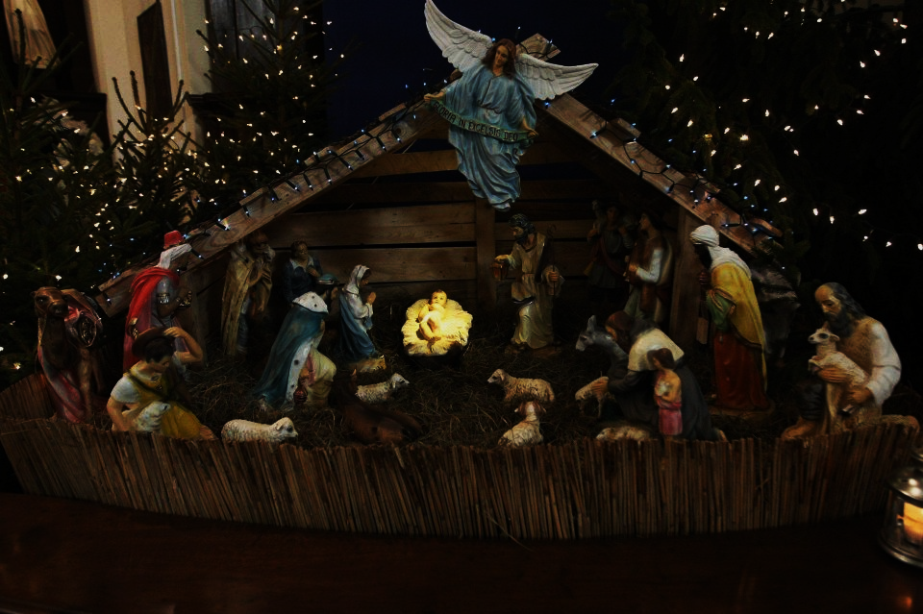
Polish nativity scenes come from Italy and came to us together with the Franciscan order.

Slide 14
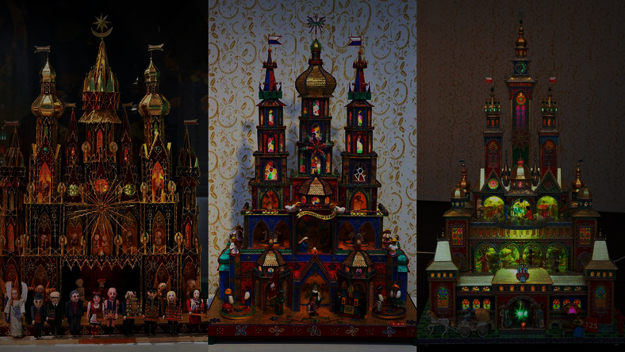
Among the many traditions of Polish cribs, the so-called Cracow cribs, valued and known since the 19th century. Since 1927 there has even been a tradition of competition for the most beautiful copy of it. The annual exhibition of these cribs takes place near the Adam Mickiewicz monument on the Krakow Market Square.

Slide 15
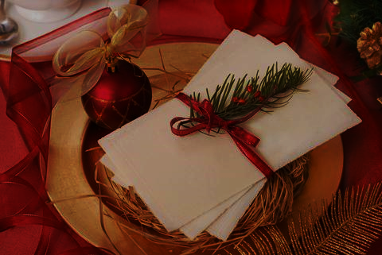
Christmas wafer

Slide 16
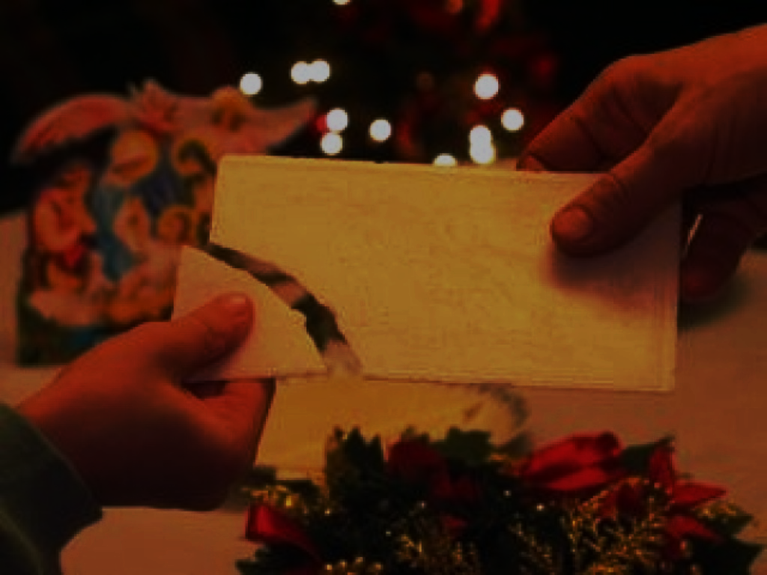
Traditionally, eating a Christmas Eve supper is preceded by sharing a white wafer, which is very thin, unleavened bread. We share our wishes by sharing the wafer. A broken, white wafer is a beautiful sign, expressing the love and unity of Christmas Eve participants.

Slide 17
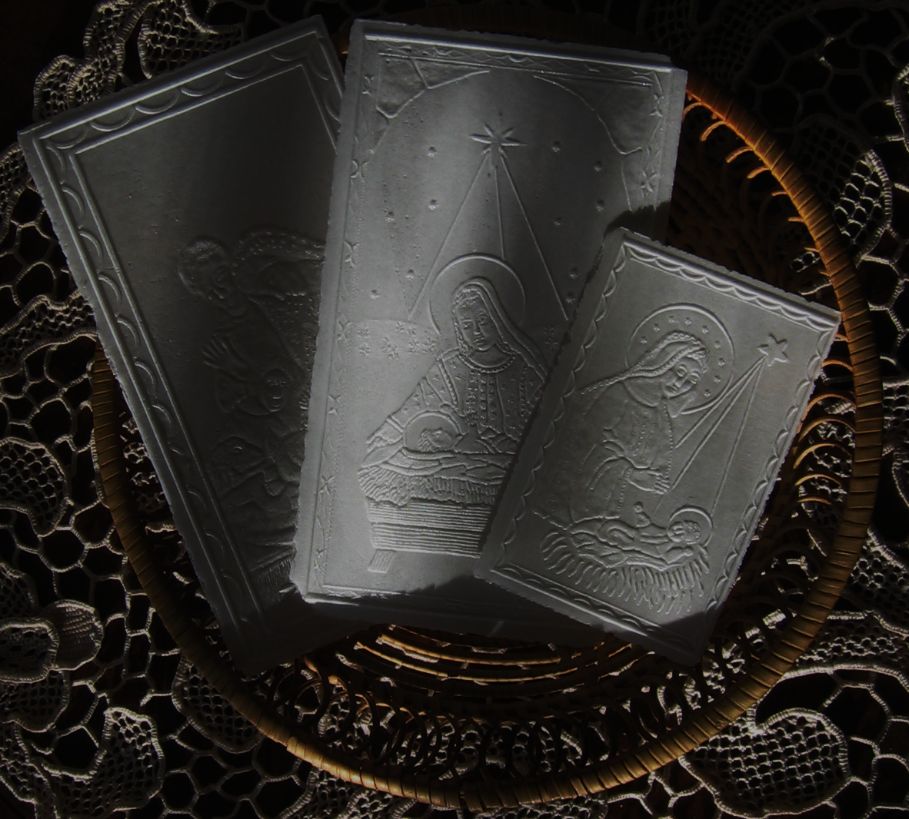
It is not known exactly when and in what circumstances this tradition took root in Poland. The oldest mention of this practice in Polish families comes from the late 18th century. Today it is only Polish custom.

Slide 18
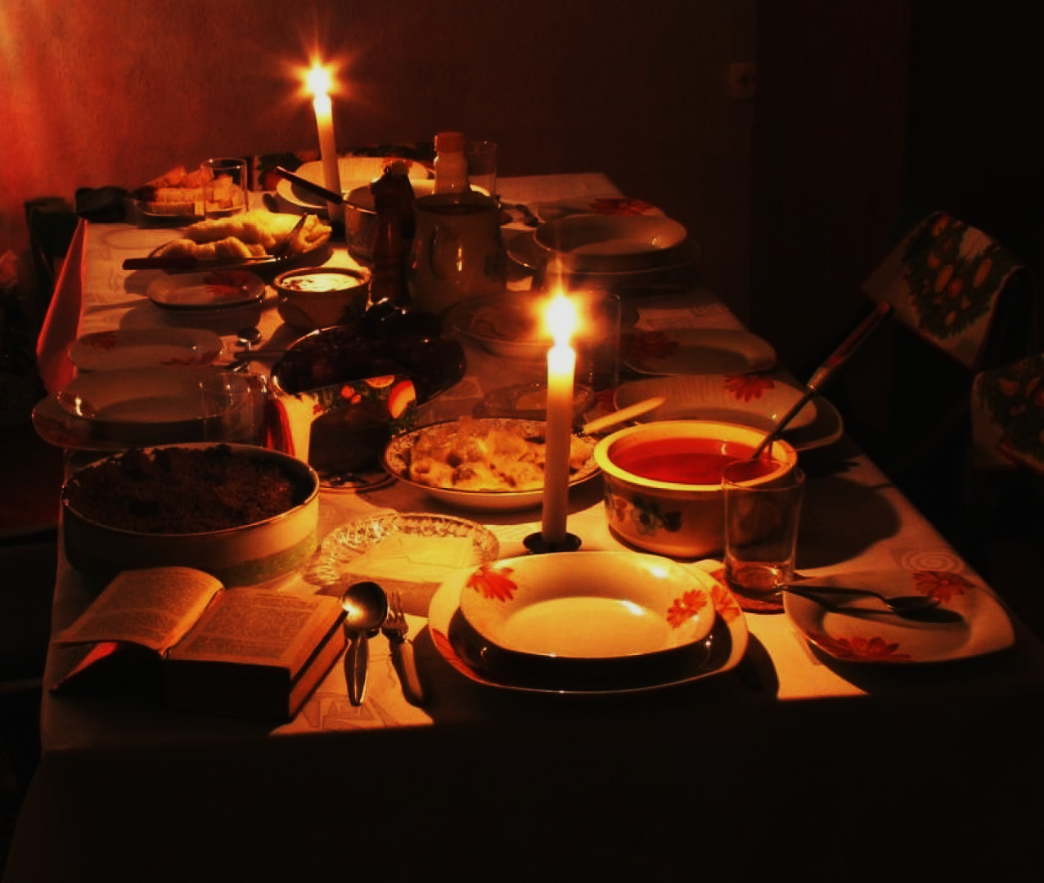
Eve

Slide 19
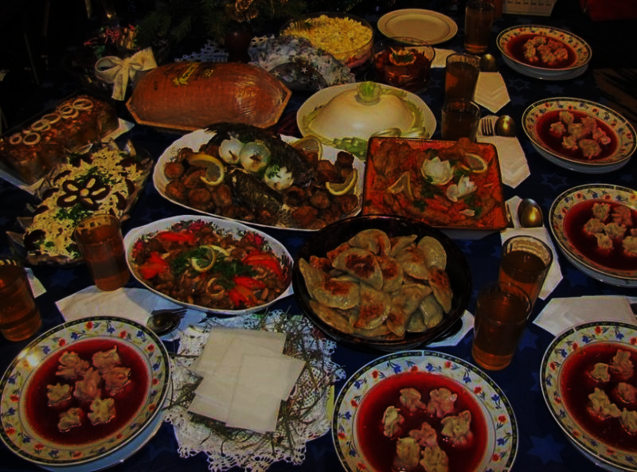
Christmas Eve is the day preceding Christmas.
On Christmas Eve we gather in a group of relatives to expect the coming of Jesus. Polish tradition requires that people sit at the supper when the first star in the sky shines. This star is a symbol of the Star of Bethlehem.

Slide 20
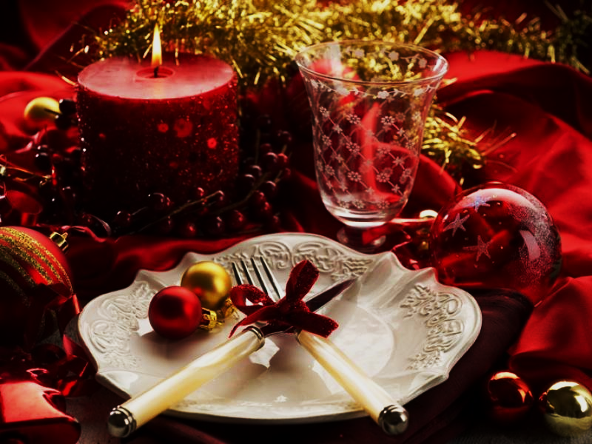
It is customary to leave free tableware for a possible guest, or symbolically for Christ.

Slide 21
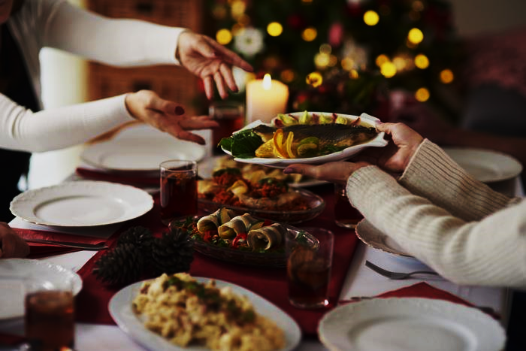
Christmas Eve dinner

Slide 22
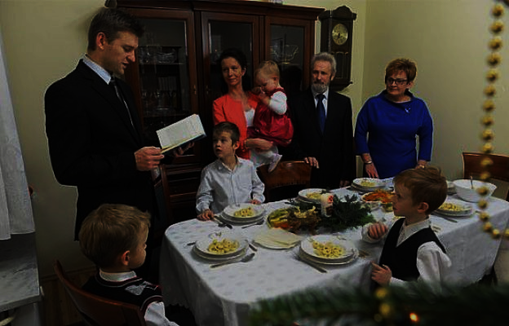
At the beginning of the Christmas Eve supper, a Gospel passage is read about the birth of Jesus. Then everyone shares the wafer and wishes each other.

Slide 23
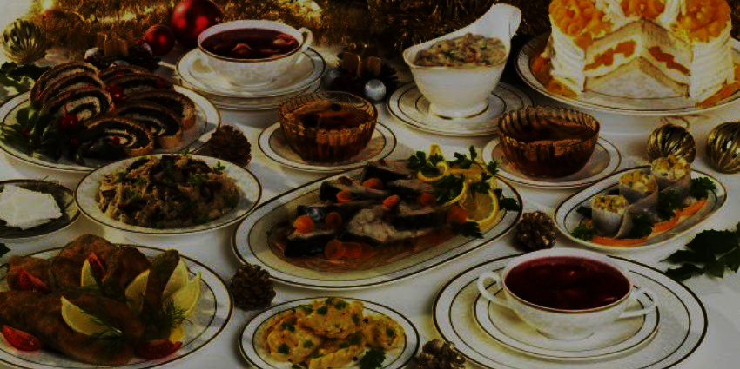
Generally, 7, 9 or 12 dishes are prepared.

Slide 24
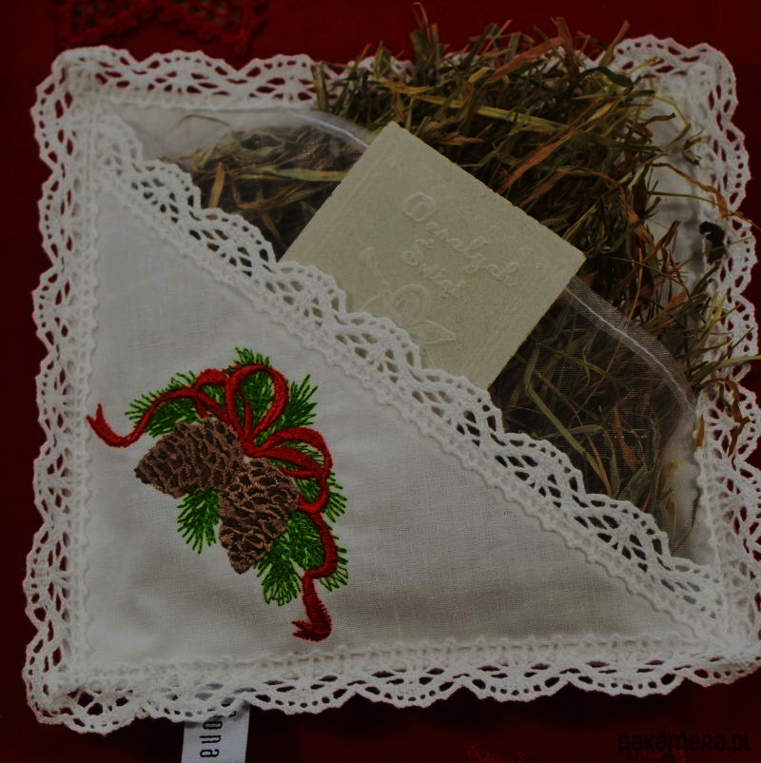
Hay is put under the tablecloth. This is a reference to the crib where, according to tradition, the Lord Jesus was born.

Slide 25
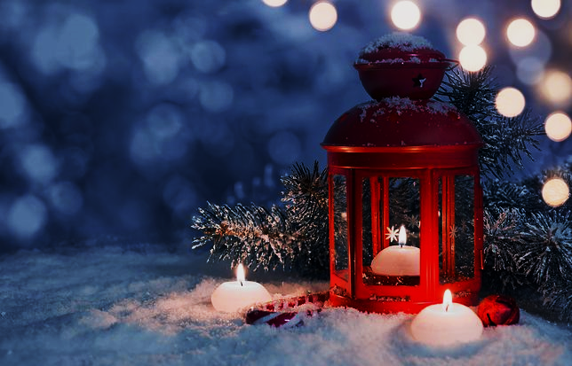
Thank you for your attention!
Merry
Christmas!

